Slide 1
Library Management System With Digital Access
SlideMake.com

Slide 2
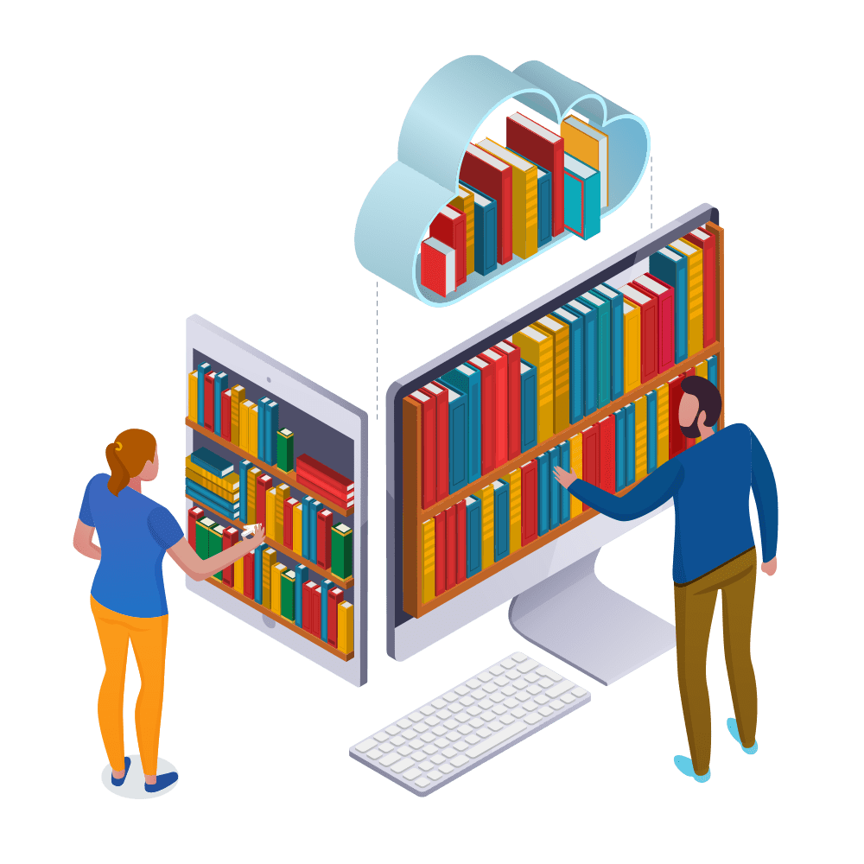
Introduction to Library Management System with Digital Access
A library management system with digital access is a software solution that helps libraries efficiently manage their resources and services online.
It allows users to access library materials, search the catalog, and borrow digital content remotely.
By integrating digital access, libraries can reach a broader audience and provide convenient services to their patrons.
Notes:
Image source: https://www.skoolbeep.com/blog/library-management-system/

Slide 3
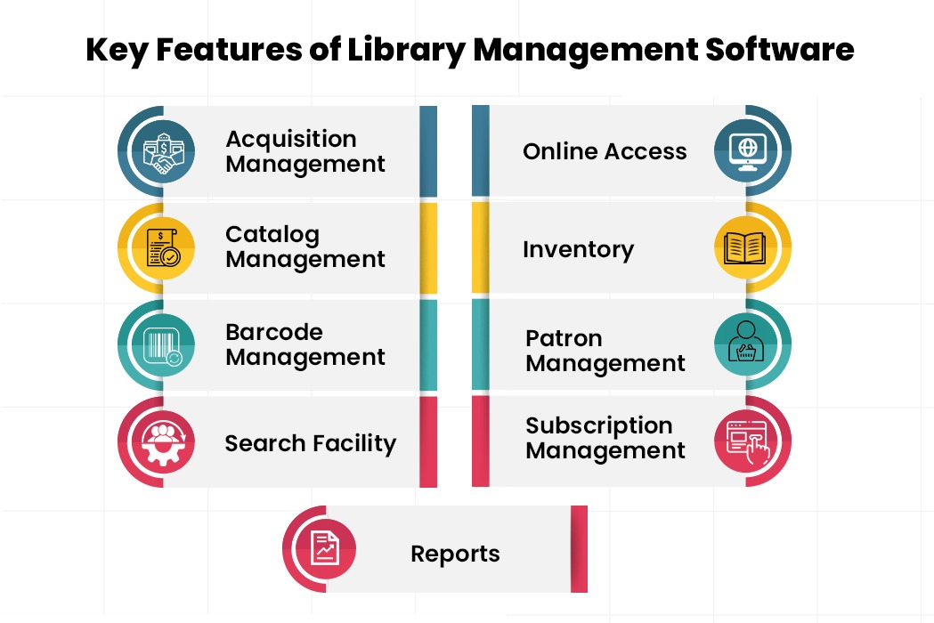
Key Features of Library Management System with Digital Access
The system offers online catalog search functionality for users to easily find and access library materials.
Patrons can remotely borrow e-books, audiobooks, and other digital content through the platform.
Library staff can efficiently manage acquisitions, circulation, and user accounts through a centralized system.
Notes:
Image source: https://itechindia.co/blog/what-features-should-your-library-management-system-have/

Slide 4
Benefits of Using a Library Management System with Digital Access
Enhanced accessibility for patrons, allowing them to access library resources from anywhere at any time.
Improved efficiency for library staff by automating routine tasks such as checkouts, renewals, and reservations.
Increased visibility and reach for the library, attracting new users and engaging existing patrons through digital services.
Notes:
Image source: https://itechindia.co/blog/what-features-should-your-library-management-system-have/

Slide 5
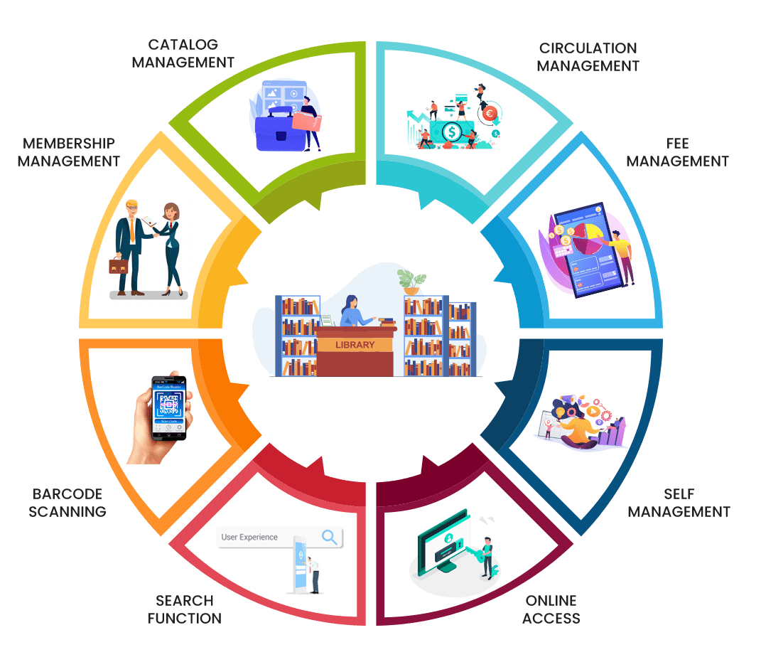
Integration of Digital Access in Library Services
Digital access can be integrated with existing library services such as interlibrary loan, reference assistance, and community programs.
Libraries can offer virtual events, workshops, and book clubs to engage patrons online through the management system.
The system can support multiple formats of digital content, including streaming media, online databases, and digital archives.
Notes:
Image source: https://www.skoolbeep.com/blog/library-management-system/

Slide 6
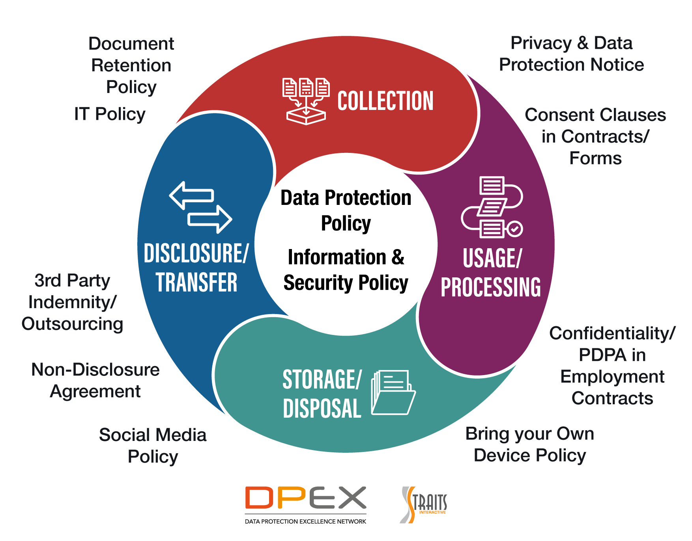
Security and Privacy Considerations in Digital Library Management
Implementing secure authentication measures, data encryption, and access controls to protect user information and library resources.
Ensuring compliance with privacy regulations such as GDPR and HIPAA to safeguard patron data and maintain confidentiality.
Regular monitoring, updates, and backups to prevent data breaches and ensure the system's reliability and security.
Notes:
Image source: https://marketing.genexist.com/articles/data-protection-controls-what-is-it/

Slide 7
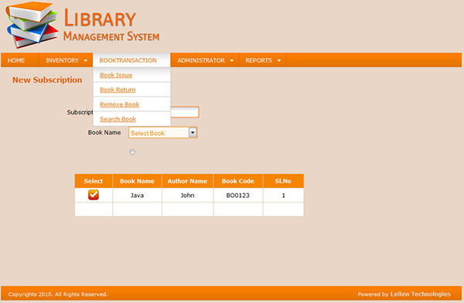
User Experience and Interface Design in Library Management System
Designing a user-friendly interface with intuitive navigation, search functionalities, and personalized recommendations for users.
Providing responsive design for seamless access across different devices, including desktops, tablets, and smartphones.
Incorporating feedback mechanisms and user testing to continuously improve the user experience and address usability issues.
Notes:
Image source: http://behance.net/gallery/1015173/library-management-system

Slide 8
Customization and Scalability of Library Management System
The system should offer customization options for libraries to tailor the interface, workflows, and services according to their needs.
Scalability features to accommodate the growth of library collections, users, and digital services over time.
Integration capabilities with third-party systems and APIs to expand functionality and connect with external platforms for data exchange.
Notes:
Image source: https://itechindia.co/blog/what-features-should-your-library-management-system-have/

Slide 9

Training and Support for Library Staff and Patrons
Providing comprehensive training programs for library staff to effectively use the management system and digital access features.
Offering support resources, tutorials, and help documentation for patrons to navigate the system and access library services.
Implementing a responsive help desk or chat support for troubleshooting issues, answering queries, and assisting users with technical problems.
Notes:
Image source: https://www.eventkeeper.com/code/events.cfm?curOrg=VPL

Slide 10
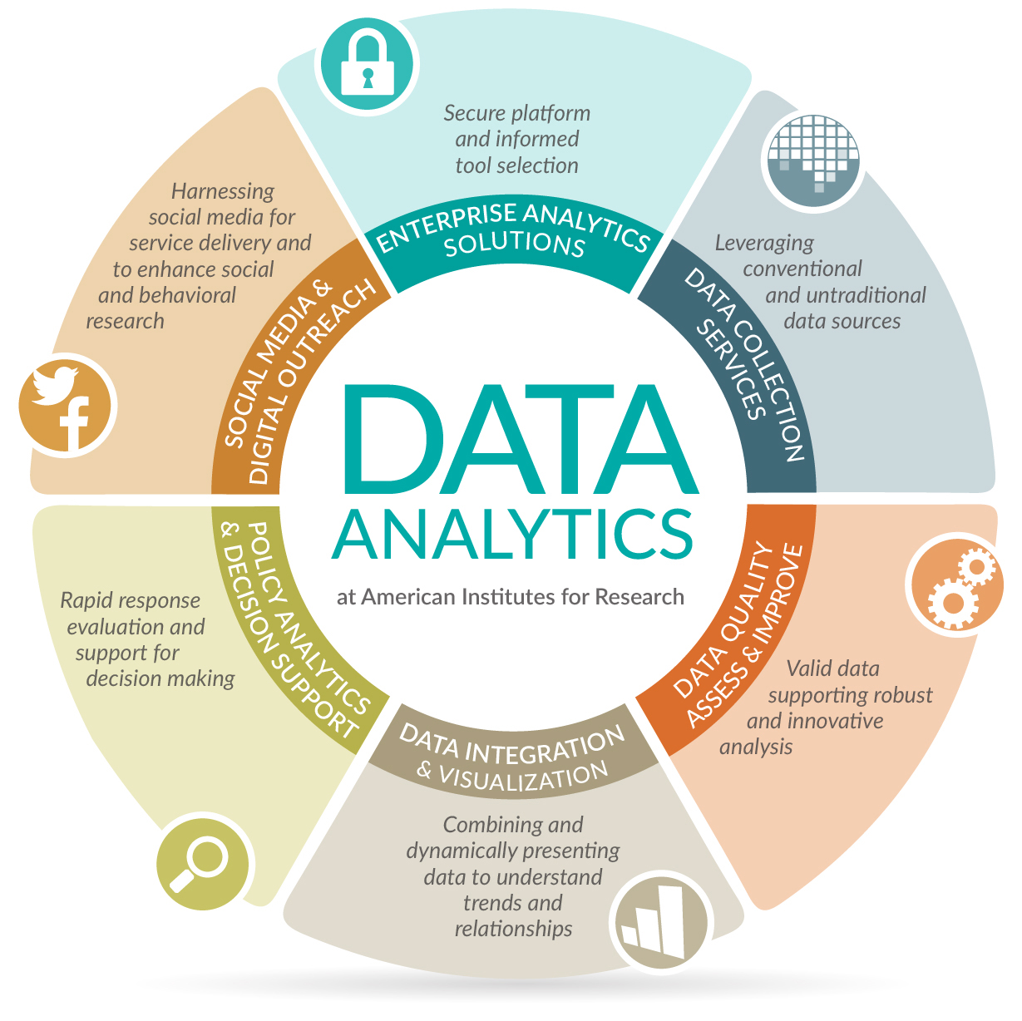
Data Analytics and Reporting in Library Management System
Utilizing data analytics tools to track usage patterns, user preferences, and trends in library resources and services.
Generating reports on circulation statistics, popular titles, overdue items, and other key performance indicators for informed decision-making.
Using data-driven insights to optimize collection development, marketing strategies, and user engagement initiatives within the library.
Notes:
Image source: https://analyticswithlf.blogspot.com/

Slide 11

Future Trends and Innovations in Library Management with Digital Access
Integration of artificial intelligence and machine learning algorithms for personalized recommendations, predictive analytics, and automation of library tasks.
Adoption of virtual reality, augmented reality, and immersive technologies to enhance user experiences and create interactive learning environments.
Collaboration with publishers, content providers, and technology companies to expand digital offerings, access exclusive content, and experiment with new formats in library services.
Notes:
Image source: https://www.slidemake.com

Slide 12
Case Studies and Success Stories of Library Management System Implementations
Highlighting examples of libraries that have successfully implemented digital access solutions and improved user satisfaction.
Showcasing innovative practices, creative initiatives, and measurable outcomes achieved through the adoption of library management systems.
Sharing lessons learned, best practices, and practical insights from real-world experiences to inspire other libraries in their digital transformation journey.
Notes:
Image source: https://www.slidemake.com

Slide 13
Conclusion and Call to Action for Library Management System with Digital Access
Emphasizing the importance of embracing digital technologies and digital access in modern library services to remain relevant and serve diverse user needs.
Encouraging libraries to invest in robust library management systems that offer digital access capabilities, scalability, and user-centered design.
Advocating for continuous learning, innovation, and collaboration in the library community to leverage digital tools and provide transformative experiences for patrons.
Notes:
Image source: https://www.slidemake.com

Slide 14
References
American Library Association. (2021). Library Management Systems. https://www.ala.org/tools/library-management-systems
OCLC. (2021). Library Management Systems. https://www.oclc.org/en/lms.html
International Federation of Library Associations and Institutions. (2021). Digital Libraries. https://www.ifla.org/digital-libraries

